Slide 1

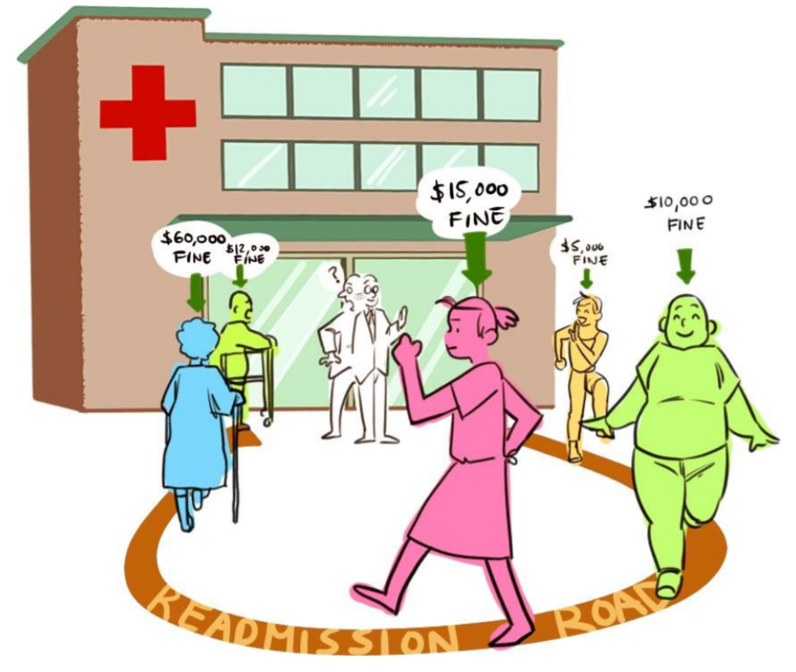
PREDICTION OF PATIENT’S READMISSION PROBABILITY IN U.S. HOSPITALS.
Mentored by,
Mr. Shashank Prakash Shirude
Submitted by,
Anandraj C
Jeshurun Paul S
Prashanth Srinivasan
Sriram Shanmugam
Victor Johnson W

Slide 2
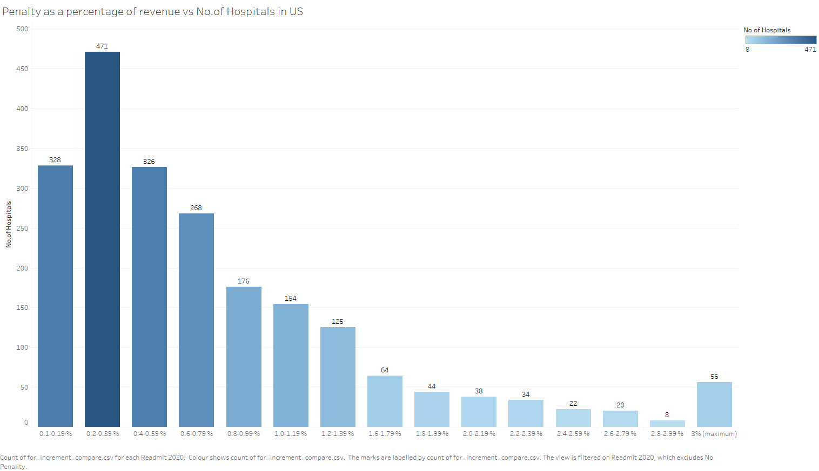
Business Problem
Hospitals in US lose a significant percentage of their revenue as a penalty for early readmissions of their patients.
Patients readmitted within 30 days might not be given proper healthcare during their admission.
It helps the hospitals identify the discharged patients who will be readmitted within 30 days, so that they might be given special attention.
This can help the hospitals reduce cost pertaining to penalty which in turn can be used to develop infrastructure and provide patients better health care.
To help doctors identify unique patterns within the data which in turn might help them revise certain practices in hospitals.
The goal of the analysis is to allow health centres to better anticipate and address unplanned readmissions while improving their quality of care and cost-efficiency.

Slide 3
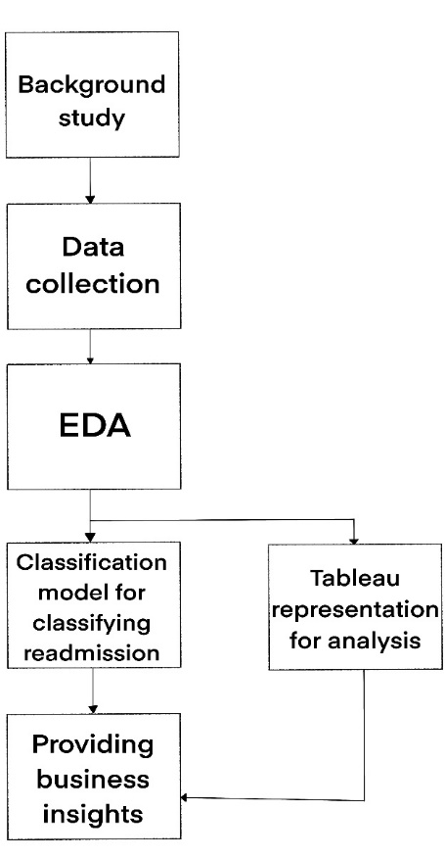
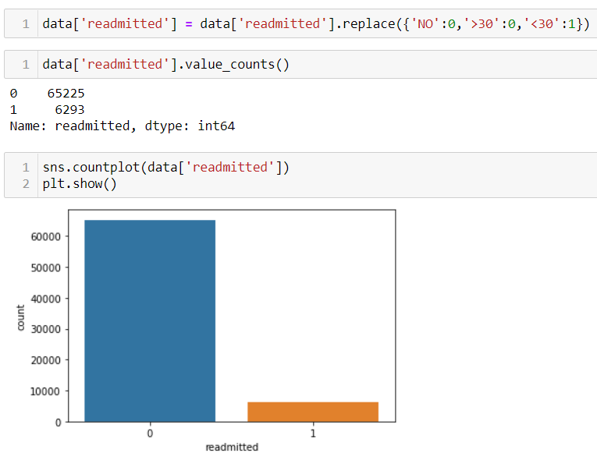

Framework
Supervised learning classification is used to classify the records into less than 30 days and more than 30 days or not readmitted.
The patient records consists of various information about their physical well-being, including the medications prescribed to them.
About the Dataset :
This dataset is taken from the Health Facts database (Cerner Corporation, Kansas City, MO) throughout the United States.
The dataset that is extracted represents 10 years (1999-2008) of clinical care at 130 hospitals throughout United States.
The database contains data systematically collected from participating institutions electronic medical records and includes encounter data (emergency, outpatient, and inpatient), provider specialty, demographics (age, sex, and race) and more.
Number of (Observations, features): (101766,50)

Slide 4
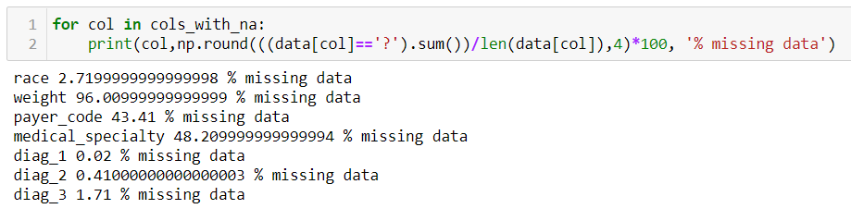
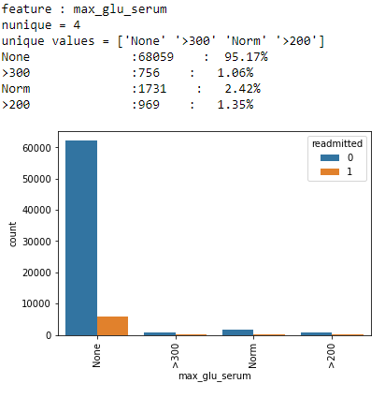
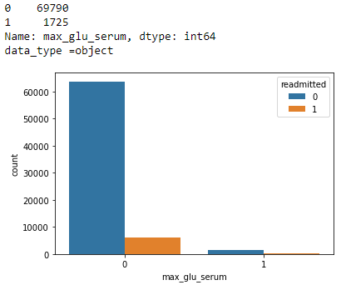

EDA and Challenges
Null values are treated.
There are no outliers treatment needed in healthcare. .
The data consists of features with multiple categories which are grouped to binary/fewer categories.
ICD9-Codes are used for grouping the features of Diag_1,Diag_2,Diag_3. One hot encoding.
Statistically significant features are observed by conducting Chi-Square test.
Feature selection is done using Backward elimination and VIF
Data balancing (Hybrid resampling – Near Miss [15:85] & SMOTE [30:70]).
Before grouping
After grouping
Hybrid Resampling

Slide 5
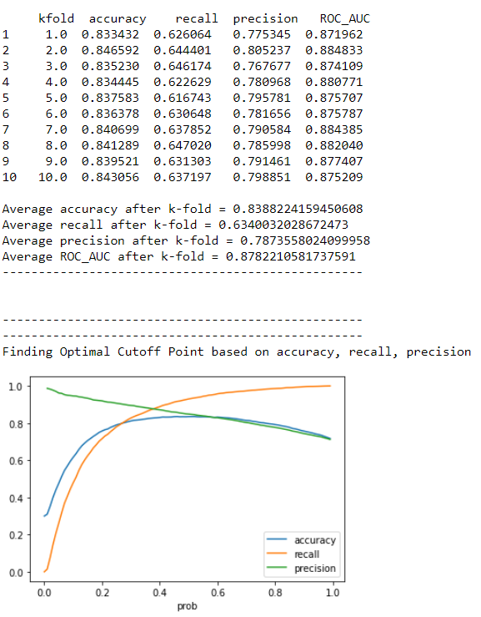
Algorithm
Algorithm used – Logistic Regression, k-Nearest Neighbors, Naïve Bayes, Decision Tree, Random Forest.
Initially the base models for all the 5 algorithms are built with accuracy, precision, recall and ROC AUC Score are observed by validating for 10 folds (k-folds).
Optimum cut-off point is chosen which returns the maximum possible value of accuracy, precision, recall without a trade-off among each other.
The comparison charts for all the algorithms and along with their cut-off point is shown in the upcoming slides.
Hyperparameter tuning for better optimization.
Randomsearch CV for finding the best parameters .
Finding Optimum cut-off point
Why Random Search CV?
Though grid search cv has higher chances of finding the optimal parameter, the chances are comparatively similar in random search because of the random search pattern where the model might end up being trained on the optimized parameters without any aliasing.

Slide 6
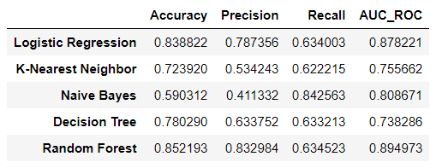
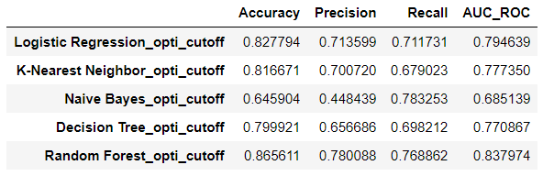
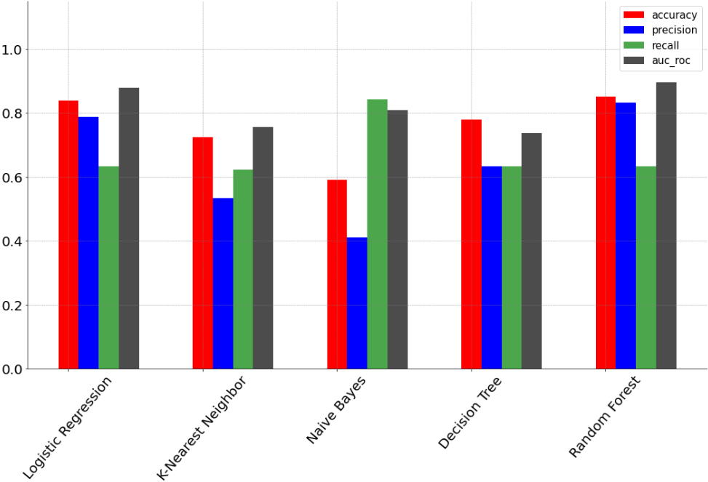
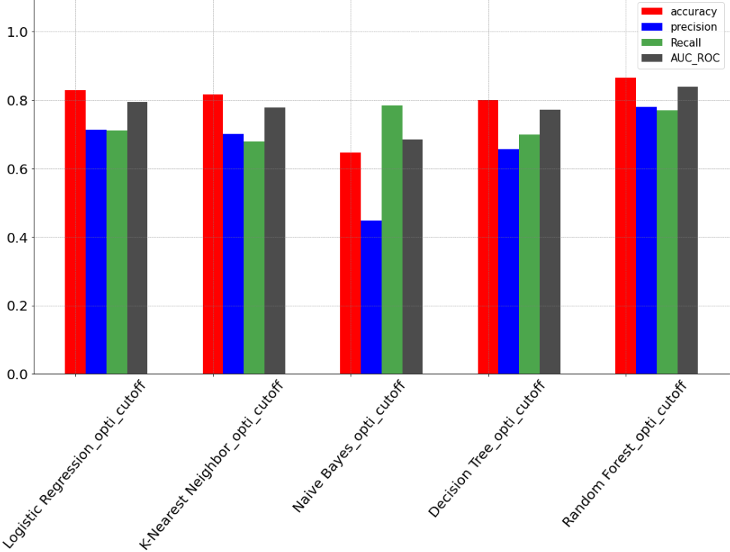
Model comparison – Base Models
Base models
Base models with optimum cut-off point

Slide 7
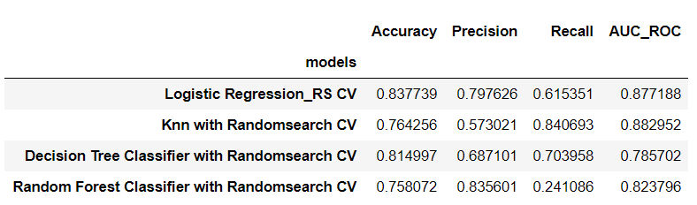
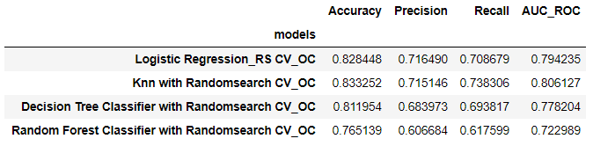
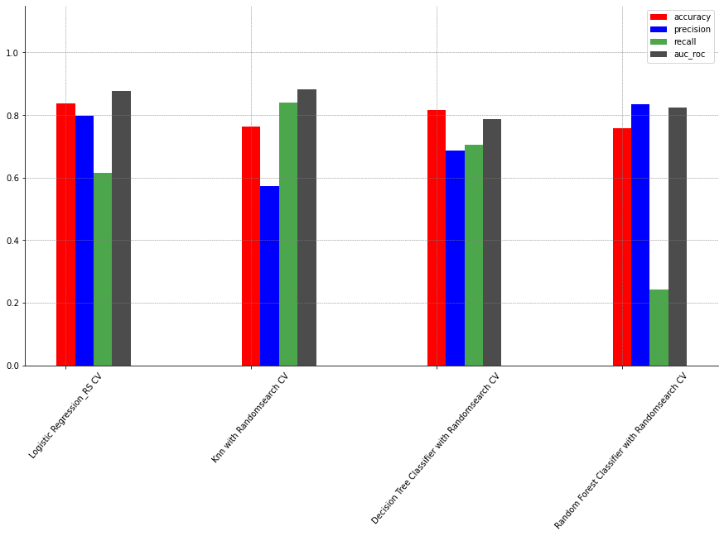
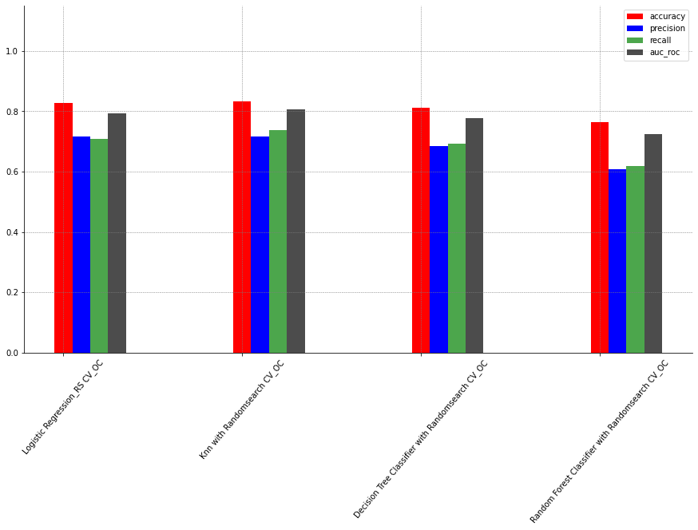
Model comparison – Tuned Models
Tuned Models
Tuned Models with optimum cut-off point

Slide 8
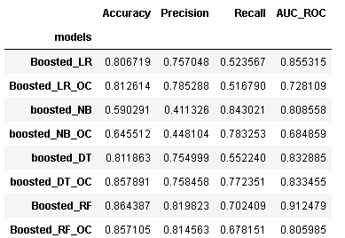
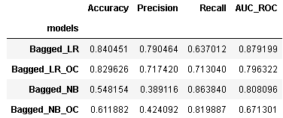
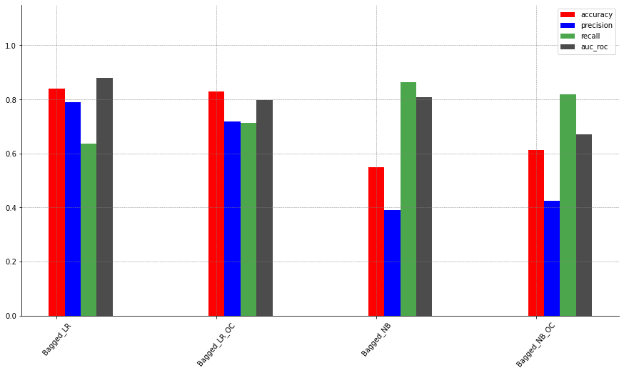
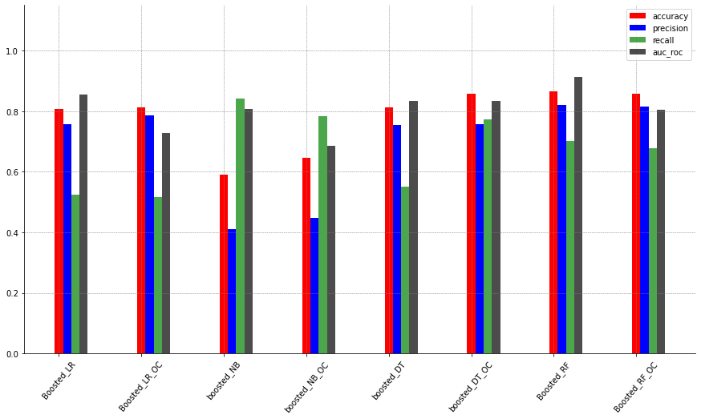
Model comparison – Ensemble Models
Bagged models with and without optimum cut-off point
Boosted models with and without optimum cut-off point

Slide 9
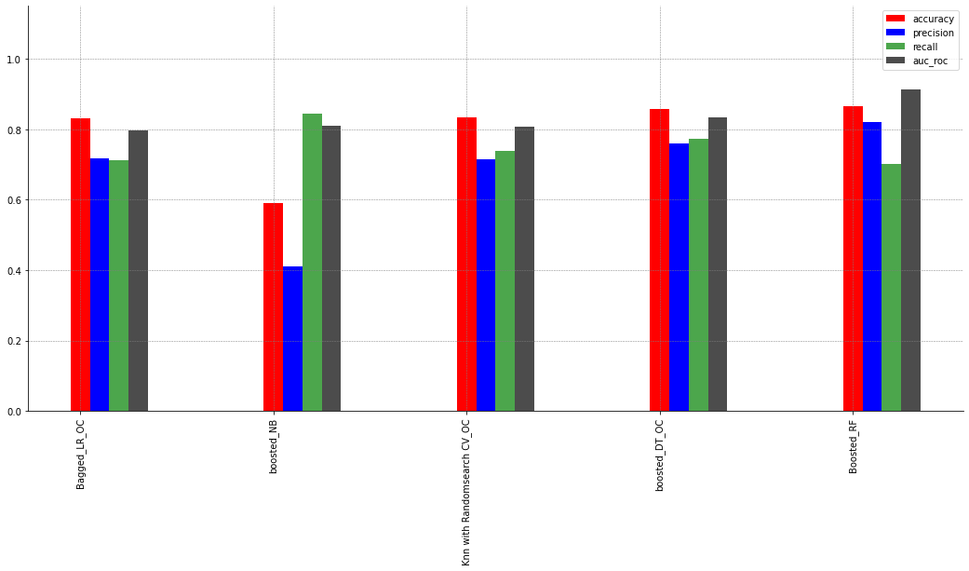
Model comparison – Final Models

Slide 10
Conclusion and Future Scope
The best model chosen is Boosted Decision Tree with Optimum Cut-off and hence it can be taken into production where a different set of test data will be used and the classification can be performed with the obtained confidence as inferred from the model’s metrics.
This can help them cut costs in penalty which can further be diverted to funds that can support free medical camps which can help get a patient free diagnosis for his medical complications.
The reduced costs from penalty can support in developing the infrastructure of hospitals and afford advanced equipment for better healthcare practices.

Slide 11

Any questions?

Slide 12

Thank you!

Slide 13
Annexure
Statistically Significance Features
Chi-Square test is done on the cleaned data in a loop for all the features and its significance is checked for 95% confidence limit and hence the attributes with P-value less than 0.05 are printed and are found out to be 44 features.
'age', 'time_in_hospital', 'num_lab_procedures', 'num_procedures', 'num_medications’, 'number_diagnoses', 'max_glu_serum', 'A1Cresult’, 'metformin', 'repaglinide', 'glipizide’, 'insulin', 'change', 'diabetesMed', 'readmitted', 'number_of_revisit', 'critical_visits’, 'num_med_change’, 'admission_source_id_7', 'admission_type_id_3', 'diag_1_5.0’, 'diag_1_7.0', 'diag_1_8.0', 'diag_1_9.0', 'diag_1_11.0', 'diag_1_16.0', 'diag_1_17.0', 'diag_2_2.0', 'diag_2_3.0', 'diag_2_11.0', 'diag_2_12.0', 'diag_3_2.0', 'diag_3_3.0’, 'diag_3_6.0', 'diag_3_8.0', 'diag_3_11.0', 'diag_3_12.0', 'diag_3_16.0’, 'discharge_disposition_id_2', 'discharge_disposition_id_10', 'discharge_disposition_id_13’, 'discharge_disposition_id_28’, 'race_Caucasian', 'race_Other’.
Feature Selection
Features removed using Backward elimination.
'age', 'A1Cresult', 'acetohexamide', 'tolbutamide', 'acarbose', 'troglitazone', 'glipizidemetformin', ‘glimepiride-pioglitazone', 'metformin rosiglitazone', 'metformin-pioglitazone’, 'admission_source_id_9', 'admission_source_id_12', 'admission_type_id_5', 'diag_3_14.0’, 'discharge_disposition_id_9', 'discharge_disposition_id_18', 'race_Hispanic', 'race_Other’.
Features removed using VIF.
'num_med_change', 'diag_1_7.0', 'diag_2_7.0', 'number_diagnoses', ‘diabetesMed’
Final observations and features : (71515,78)

Slide 14
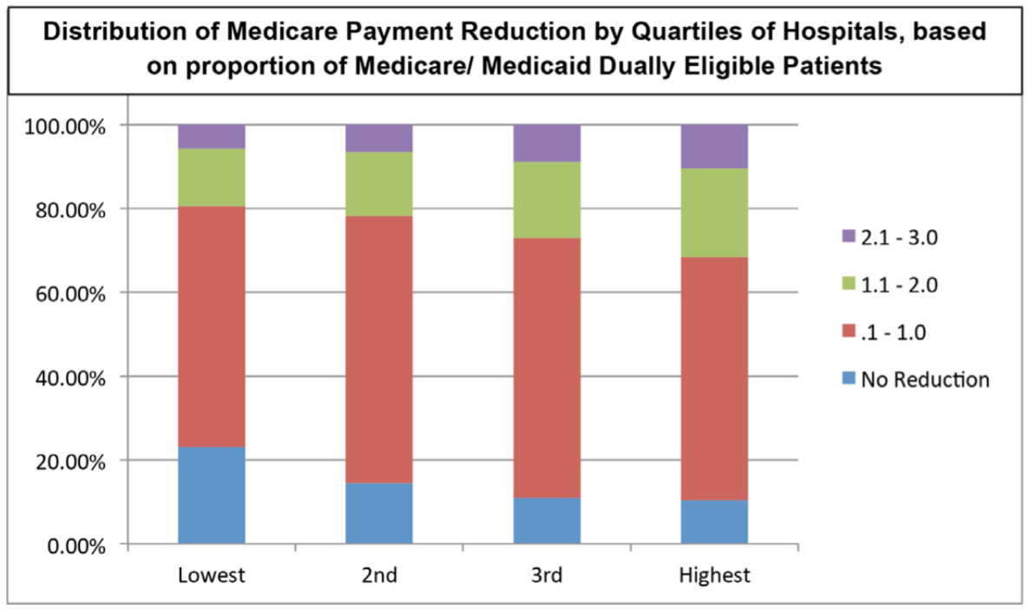
Annexure
Journal of the American Heart Association :
“Potential to Disproportionately Penalize Hospitals Serving Indigent Populations Despite the above-mentioned successes, there has been considerable discussion of the methodology for calculating excess readmissions. The initial risk-adjustment models did not adjust for socioeconomic status. Several analyses have shown that caring for patients with a lower socioeconomic status puts a hospital at higher risk of incurring penalties. This means that the HRRP may unintentionally be taking away resources from hospitals such as safety-net hospitals that care for disadvantaged populations.”
Article by : Colleen K. McIlvennan, DNP, ANP; Zubin J. Eapen, MD, MHS; Larry A. Allen, MD, MHS
The British Medical Journal :
“In the United States, total hospital revisits within 30 days of discharge for conditions targeted by the HRRP increased across the study period. This increase was due to a rise in post-discharge emergency department visits and observation stays, which exceeded the decline in readmissions. Although reductions in readmissions have been attributed to improvements in discharge planning and care transitions, our findings suggest that these declines could instead be because hospitals and clinicians have intensified efforts to treat patients who return to a hospital within 30 days of discharge in emergency departments and as observation stays.”
Article by : Rishi K Wadhera

